Slide 1
MAZE PARSER FOR ROBOTS
TOTAL
ROBOT DOMINATION

Slide 2


Slide 3
Appendix

Slide 5
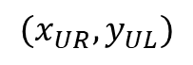
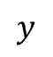
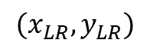
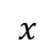
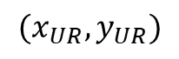
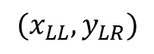
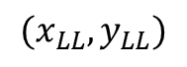
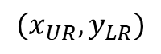
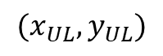
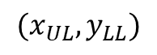
$$x$$
$$(x_{UR},y_{UR})$$
$$(x_{UL},y_{UL})$$
$$(x_{UR},y_{UL})$$
$$(x_{UL},y_{LL})$$
$$(x_{LL},y_{LR})$$
$$(x_{LL},y_{LL})$$
$$(x_{UR},y_{LR})$$
$$(x_{LR},y_{LR})$$
$$y$$

Slide 6
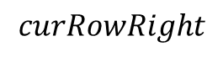
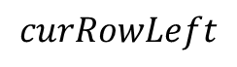
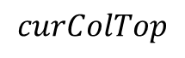
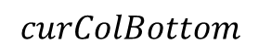
$$x$$
$$curColTop$$
$$curRowLeft$$
$$curRowRight$$
$$curColBottom$$
$$y$$

Slide 7
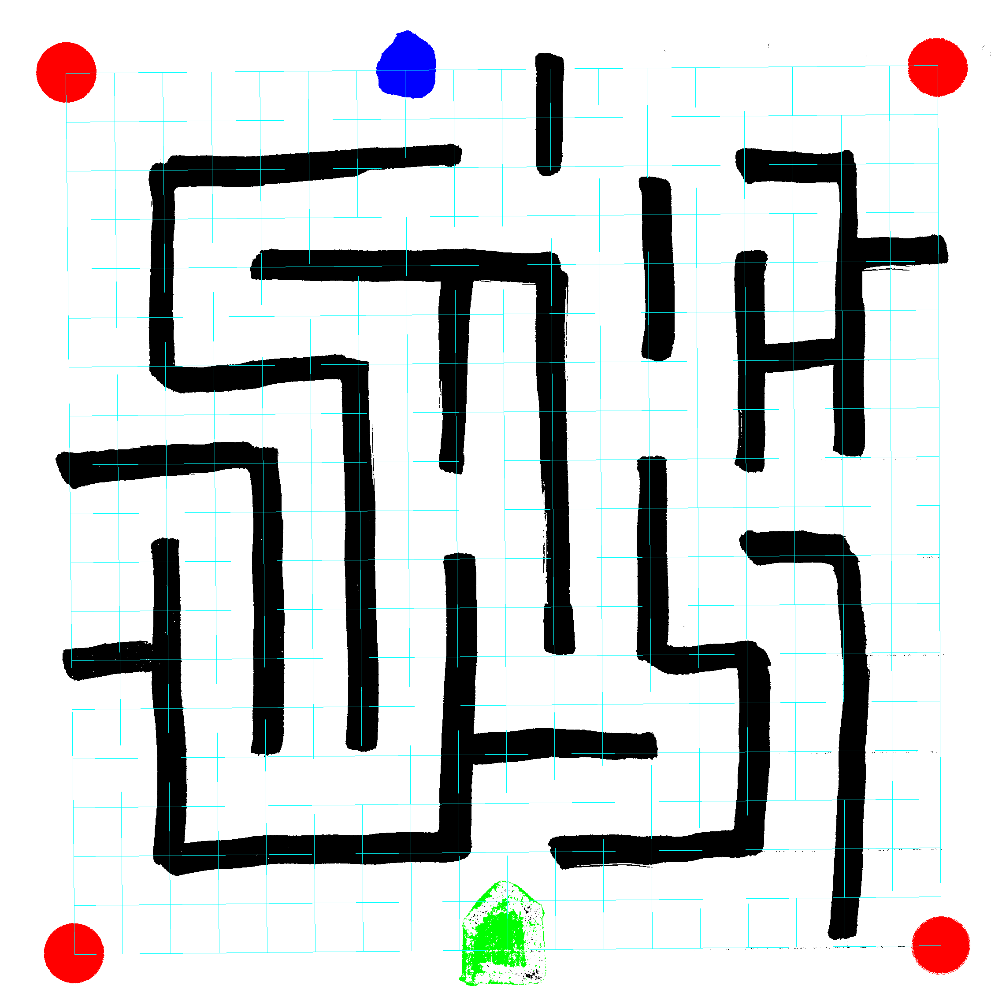
Maze 1 Straight
0 | 0 | 0 | 0 | 0 | 0 | 0 | 3 | 0 | 0 | 1 | 0 | 0 | 0 | 0 | 0 | 0 | 0 | 0
0 | 0 | 0 | 0 | 0 | 0 | 0 | 0 | 0 | 0 | 1 | 0 | 0 | 0 | 0 | 0 | 0 | 0 | 0
0 | 0 | 1 | 1 | 1 | 1 | 1 | 0 | 0 | 0 | 1 | 0 | 0 | 0 | 1 | 1 | 1 | 0 | 0
0 | 0 | 1 | 0 | 0 | 0 | 0 | 0 | 0 | 0 | 0 | 0 | 1 | 0 | 0 | 0 | 1 | 0 | 0
0 | 0 | 1 | 0 | 1 | 1 | 1 | 1 | 1 | 1 | 1 | 0 | 1 | 0 | 1 | 0 | 1 | 1 | 1
0 | 0 | 1 | 0 | 0 | 0 | 0 | 0 | 1 | 0 | 1 | 0 | 1 | 0 | 1 | 0 | 1 | 0 | 0
0 | 0 | 1 | 0 | 1 | 1 | 1 | 0 | 1 | 0 | 1 | 0 | 0 | 0 | 1 | 1 | 1 | 0 | 0
0 | 0 | 0 | 0 | 0 | 0 | 1 | 0 | 1 | 0 | 1 | 0 | 0 | 0 | 1 | 0 | 1 | 0 | 0
1 | 1 | 1 | 1 | 1 | 0 | 1 | 0 | 1 | 0 | 1 | 0 | 1 | 0 | 1 | 0 | 0 | 0 | 0
0 | 0 | 0 | 0 | 1 | 0 | 1 | 0 | 0 | 0 | 1 | 0 | 1 | 0 | 0 | 0 | 0 | 0 | 0
0 | 0 | 1 | 0 | 1 | 0 | 1 | 0 | 1 | 0 | 1 | 0 | 1 | 0 | 0 | 1 | 1 | 0 | 0
0 | 0 | 1 | 0 | 1 | 0 | 1 | 0 | 1 | 0 | 1 | 0 | 1 | 0 | 0 | 0 | 1 | 0 | 0
1 | 1 | 1 | 0 | 1 | 0 | 1 | 0 | 1 | 0 | 0 | 0 | 1 | 1 | 1 | 0 | 1 | 0 | 0
0 | 0 | 1 | 0 | 1 | 0 | 1 | 0 | 1 | 0 | 0 | 0 | 0 | 0 | 1 | 0 | 1 | 0 | 0
0 | 0 | 1 | 0 | 0 | 0 | 0 | 0 | 1 | 1 | 1 | 1 | 1 | 0 | 1 | 0 | 1 | 0 | 0
0 | 0 | 1 | 0 | 0 | 0 | 0 | 0 | 1 | 0 | 0 | 0 | 0 | 0 | 1 | 0 | 1 | 0 | 0
0 | 0 | 1 | 1 | 1 | 1 | 1 | 1 | 1 | 0 | 1 | 1 | 1 | 1 | 1 | 0 | 1 | 0 | 0
0 | 0 | 0 | 0 | 0 | 0 | 0 | 0 | 0 | 2 | 0 | 0 | 0 | 0 | 0 | 0 | 1 | 0 | 0
0 | 0 | 0 | 0 | 0 | 0 | 0 | 0 | 0 | 0 | 0 | 0 | 0 | 0 | 0 | 0 | 0 | 0 | 0

Slide 8
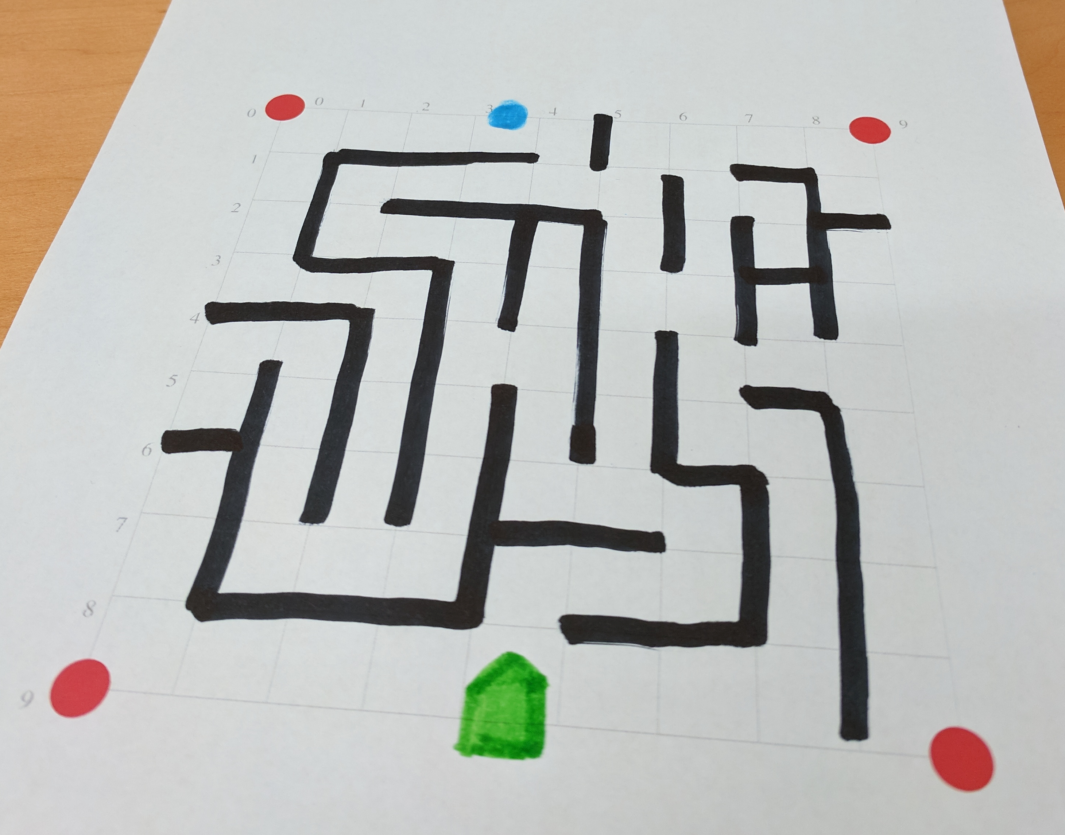
Maze 1 Perspective - Drawing

Slide 9
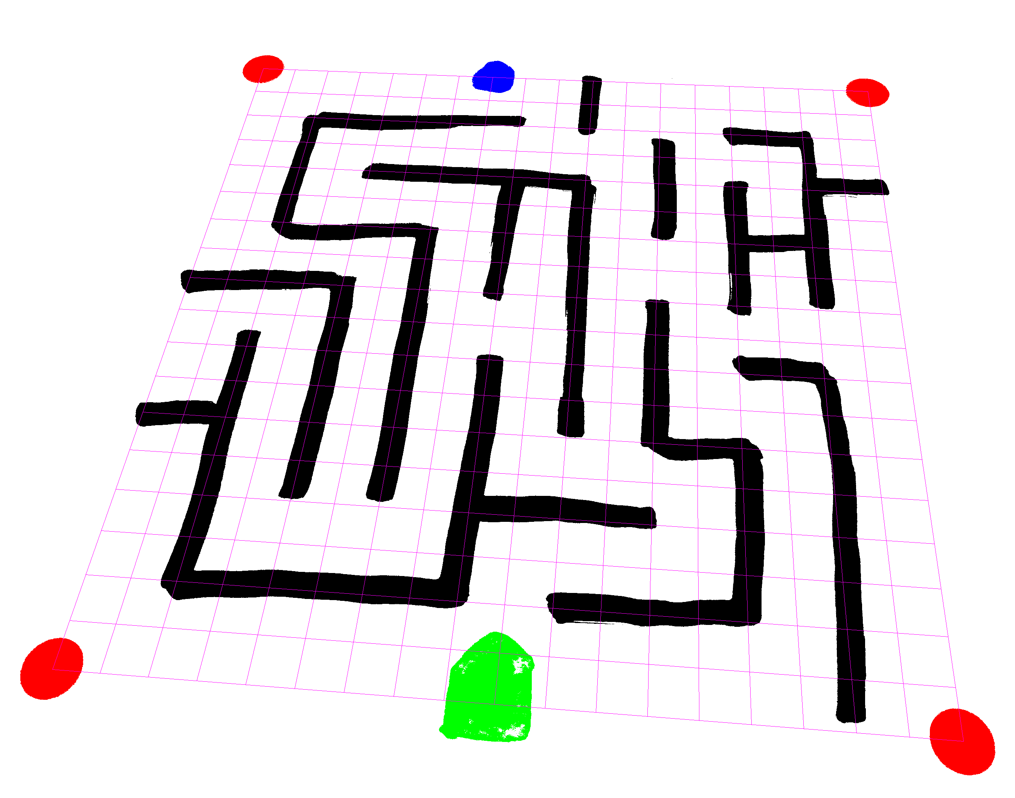
Maze 1 - Perspective - Parsing
0 | 0 | 0 | 0 | 0 | 0 | 0 | 3 | 0 | 0 | 1 | 0 | 0 | 0 | 0 | 0 | 0 | 0 | 0
0 | 0 | 0 | 0 | 0 | 0 | 0 | 0 | 0 | 0 | 1 | 0 | 0 | 0 | 0 | 0 | 0 | 0 | 0
0 | 0 | 1 | 1 | 1 | 1 | 1 | 1 | 1 | 0 | 1 | 0 | 0 | 0 | 1 | 1 | 1 | 0 | 0
0 | 0 | 1 | 0 | 0 | 0 | 0 | 0 | 0 | 0 | 0 | 0 | 1 | 0 | 0 | 0 | 1 | 0 | 0
0 | 0 | 1 | 0 | 1 | 1 | 1 | 1 | 1 | 1 | 1 | 0 | 1 | 0 | 1 | 0 | 1 | 1 | 1
0 | 0 | 1 | 0 | 0 | 0 | 0 | 0 | 1 | 0 | 1 | 0 | 1 | 0 | 1 | 0 | 1 | 0 | 0
0 | 0 | 1 | 0 | 1 | 1 | 1 | 0 | 1 | 0 | 1 | 0 | 0 | 0 | 1 | 1 | 1 | 0 | 0
0 | 0 | 0 | 0 | 0 | 0 | 1 | 0 | 1 | 0 | 1 | 0 | 0 | 0 | 1 | 0 | 1 | 0 | 0
1 | 1 | 1 | 1 | 1 | 0 | 1 | 0 | 1 | 0 | 1 | 0 | 1 | 0 | 1 | 0 | 0 | 0 | 0
0 | 0 | 0 | 0 | 1 | 0 | 1 | 0 | 0 | 0 | 1 | 0 | 1 | 0 | 0 | 0 | 0 | 0 | 0
0 | 0 | 1 | 0 | 1 | 0 | 1 | 0 | 1 | 0 | 1 | 0 | 1 | 0 | 0 | 1 | 1 | 0 | 0
0 | 0 | 1 | 0 | 1 | 0 | 1 | 0 | 1 | 0 | 1 | 0 | 1 | 0 | 0 | 0 | 1 | 0 | 0
1 | 1 | 1 | 0 | 1 | 0 | 1 | 0 | 1 | 0 | 0 | 0 | 1 | 1 | 1 | 0 | 1 | 0 | 0
0 | 0 | 1 | 0 | 1 | 0 | 1 | 0 | 1 | 0 | 0 | 0 | 0 | 0 | 1 | 0 | 1 | 0 | 0
0 | 0 | 1 | 0 | 0 | 0 | 0 | 0 | 1 | 1 | 1 | 1 | 1 | 0 | 1 | 0 | 1 | 0 | 0
0 | 0 | 1 | 0 | 0 | 0 | 0 | 0 | 1 | 0 | 0 | 0 | 0 | 0 | 1 | 0 | 1 | 0 | 0
0 | 0 | 1 | 1 | 1 | 1 | 1 | 1 | 1 | 0 | 1 | 1 | 1 | 1 | 1 | 0 | 1 | 0 | 0
0 | 0 | 0 | 0 | 0 | 0 | 0 | 0 | 0 | 2 | 0 | 0 | 0 | 0 | 0 | 0 | 1 | 0 | 0
0 | 0 | 0 | 0 | 0 | 0 | 0 | 0 | 0 | 2 | 0 | 0 | 0 | 0 | 0 | 0 | 0 | 0 | 0

Slide 10
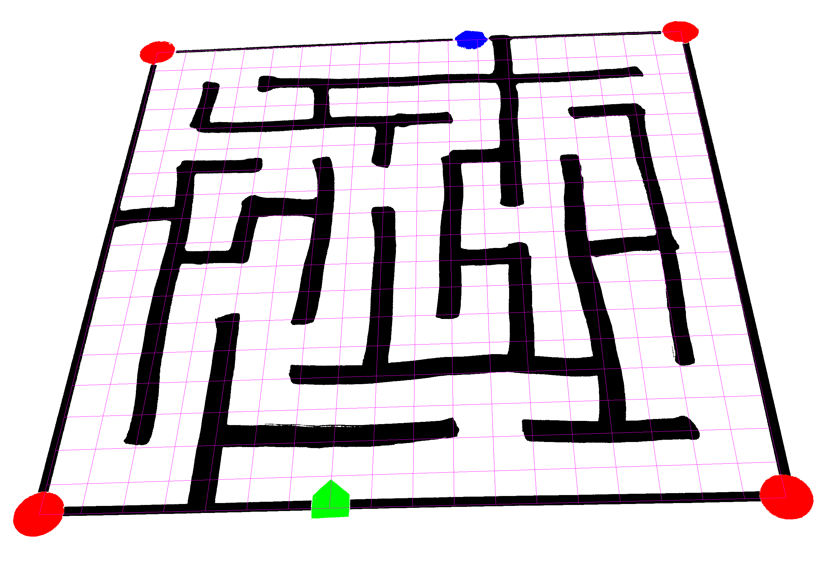
Maze 3 - Perspective
0 | 1 | 1 | 1 | 1 | 1 | 1 | 1 | 0 | 1 | 1 | 3 | 1 | 1 | 1 | 1 | 1 | 1 | 0
1 | 0 | 0 | 0 | 0 | 0 | 0 | 0 | 0 | 0 | 0 | 0 | 1 | 0 | 0 | 0 | 0 | 0 | 1
1 | 0 | 1 | 0 | 1 | 1 | 1 | 1 | 1 | 1 | 1 | 1 | 1 | 1 | 1 | 1 | 1 | 0 | 1
1 | 0 | 1 | 0 | 0 | 0 | 1 | 0 | 0 | 0 | 0 | 0 | 1 | 0 | 0 | 0 | 0 | 0 | 1
1 | 0 | 1 | 1 | 1 | 1 | 1 | 1 | 1 | 1 | 1 | 0 | 1 | 0 | 1 | 1 | 1 | 0 | 1
1 | 0 | 0 | 0 | 0 | 0 | 0 | 0 | 1 | 0 | 0 | 0 | 1 | 0 | 0 | 0 | 1 | 0 | 1
1 | 0 | 1 | 1 | 1 | 0 | 1 | 0 | 1 | 0 | 1 | 0 | 1 | 0 | 1 | 0 | 1 | 0 | 1
1 | 0 | 1 | 0 | 0 | 0 | 1 | 0 | 0 | 0 | 1 | 0 | 1 | 0 | 1 | 0 | 1 | 0 | 1
1 | 1 | 1 | 0 | 1 | 1 | 1 | 0 | 1 | 0 | 1 | 0 | 0 | 0 | 0 | 0 | 1 | 0 | 1
1 | 0 | 1 | 0 | 1 | 0 | 1 | 0 | 1 | 0 | 1 | 0 | 0 | 0 | 0 | 0 | 1 | 0 | 1
1 | 0 | 1 | 0 | 0 | 0 | 1 | 0 | 1 | 0 | 1 | 1 | 1 | 0 | 1 | 0 | 0 | 0 | 1
1 | 0 | 1 | 0 | 0 | 0 | 1 | 0 | 1 | 0 | 1 | 0 | 1 | 0 | 1 | 0 | 1 | 0 | 1
1 | 0 | 1 | 0 | 1 | 0 | 1 | 0 | 1 | 0 | 1 | 0 | 1 | 0 | 1 | 0 | 1 | 0 | 1
1 | 0 | 1 | 0 | 1 | 0 | 0 | 0 | 1 | 0 | 0 | 0 | 1 | 0 | 1 | 0 | 1 | 0 | 1
1 | 0 | 1 | 0 | 1 | 0 | 1 | 1 | 1 | 1 | 1 | 1 | 1 | 1 | 1 | 0 | 0 | 0 | 1
1 | 0 | 1 | 0 | 1 | 0 | 0 | 0 | 0 | 0 | 0 | 0 | 0 | 0 | 1 | 0 | 0 | 0 | 1
1 | 0 | 0 | 0 | 1 | 1 | 1 | 1 | 1 | 1 | 0 | 0 | 1 | 1 | 1 | 1 | 1 | 0 | 1
1 | 0 | 0 | 0 | 1 | 0 | 0 | 0 | 0 | 0 | 0 | 0 | 0 | 0 | 0 | 0 | 0 | 0 | 1
0 | 1 | 1 | 1 | 1 | 1 | 1 | 2 | 1 | 1 | 1 | 1 | 1 | 1 | 1 | 1 | 1 | 1 | 0

Slide 11
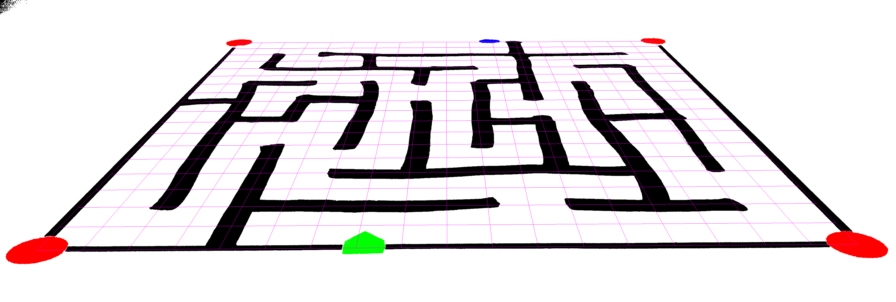
Maze 3 – Extreme Perspective
0 | 0 | 0 | 0 | 0 | 0 | 0 | 0 | 0 | 0 | 0 | 3 | 1 | 0 | 0 | 0 | 0 | 0 | 0
1 | 0 | 0 | 0 | 0 | 0 | 0 | 0 | 0 | 0 | 0 | 0 | 1 | 0 | 0 | 0 | 0 | 0 | 0
1 | 0 | 1 | 0 | 1 | 1 | 1 | 1 | 1 | 1 | 1 | 1 | 1 | 0 | 0 | 1 | 1 | 0 | 1
1 | 0 | 1 | 0 | 0 | 0 | 1 | 0 | 0 | 0 | 0 | 0 | 1 | 0 | 0 | 0 | 0 | 0 | 1
1 | 0 | 1 | 1 | 1 | 1 | 1 | 1 | 1 | 1 | 1 | 0 | 1 | 0 | 1 | 1 | 1 | 0 | 1
1 | 0 | 0 | 0 | 0 | 0 | 0 | 0 | 1 | 0 | 0 | 0 | 1 | 0 | 0 | 0 | 1 | 0 | 1
1 | 0 | 1 | 1 | 1 | 0 | 1 | 0 | 1 | 0 | 1 | 1 | 1 | 0 | 1 | 0 | 1 | 0 | 1
1 | 0 | 1 | 0 | 0 | 0 | 0 | 0 | 0 | 0 | 1 | 0 | 1 | 0 | 1 | 0 | 1 | 0 | 1
1 | 1 | 1 | 0 | 1 | 1 | 1 | 0 | 1 | 0 | 1 | 0 | 1 | 0 | 1 | 0 | 1 | 0 | 1
1 | 0 | 1 | 0 | 1 | 0 | 0 | 0 | 1 | 0 | 1 | 0 | 0 | 0 | 1 | 0 | 0 | 0 | 1
1 | 0 | 1 | 1 | 1 | 0 | 1 | 0 | 1 | 0 | 1 | 1 | 1 | 0 | 1 | 1 | 0 | 0 | 1
1 | 0 | 1 | 0 | 0 | 0 | 1 | 0 | 1 | 0 | 1 | 0 | 1 | 0 | 1 | 0 | 0 | 0 | 1
1 | 0 | 1 | 0 | 1 | 0 | 1 | 0 | 1 | 0 | 1 | 0 | 1 | 0 | 1 | 0 | 0 | 0 | 1
1 | 0 | 1 | 0 | 1 | 0 | 0 | 0 | 1 | 0 | 0 | 0 | 1 | 0 | 1 | 0 | 1 | 0 | 1
1 | 0 | 1 | 0 | 1 | 0 | 1 | 1 | 1 | 1 | 1 | 1 | 1 | 1 | 1 | 0 | 0 | 0 | 1
1 | 0 | 1 | 0 | 1 | 0 | 0 | 0 | 0 | 0 | 0 | 0 | 0 | 0 | 1 | 0 | 0 | 0 | 1
1 | 0 | 1 | 0 | 1 | 1 | 1 | 1 | 1 | 1 | 1 | 0 | 1 | 1 | 1 | 1 | 1 | 0 | 1
1 | 0 | 0 | 0 | 1 | 0 | 0 | 0 | 0 | 0 | 0 | 0 | 0 | 0 | 0 | 0 | 0 | 0 | 1
0 | 1 | 1 | 1 | 1 | 1 | 1 | 2 | 1 | 1 | 1 | 1 | 1 | 1 | 1 | 1 | 1 | 1 | 0

Slide 12
 | 1 | 3 | 5
1
3
5
 | 0 | 1 | 2 | 3
0
1
2
3

Slide 13
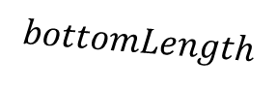
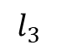
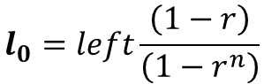
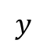
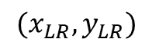
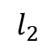
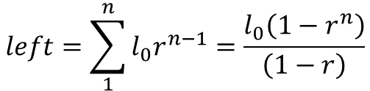
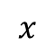
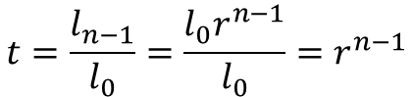
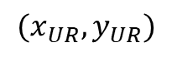
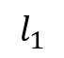
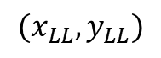
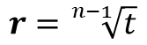
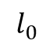
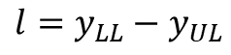
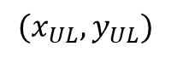
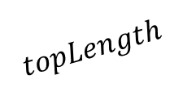
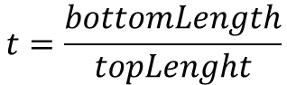
$$l={y_{LL}−y}_{UL}$$
$$x$$
$$t=\frac{bottomLength}{topLenght}$$
$$(x_{UR},y_{UR})$$
$$topLength$$
$$t=\frac{l_{n−1}}{l_{0}}=\frac{l_{0}r^{n−1}}{l_{0}}=r^{n−1}$$
$$(x_{UL},y_{UL})$$
$$l_{0}$$
$$r=\sqrt[n−1]{t}$$
$$l_{1}$$
$$l_{2}$$
$$left=\sum_{1}^{n}{l_{0}r^{n−1}}=\frac{l_{0}\left(1−r^{n}\right)}{\left(1−r\right)}$$
$$l_{3}$$
$$l_{0}=left\frac{\left(1−r\right)}{\left(1−r^{n}\right)}$$
$$(x_{LL},y_{LL})$$
$$bottomLength$$
$$(x_{LR},y_{LR})$$
$$y$$

Slide 14
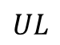
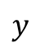
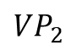
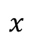
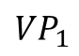
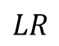
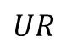
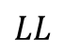
2 Vanishing Points
$${VP}_{2}$$
$$x$$
$$UL$$
$$UR$$
$${VP}_{1}$$
$$LL$$
$$LR$$
$$y$$

Slide 15
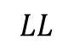
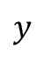
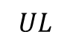
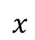
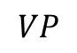


1 Vanishing Point
$$VP$$
$$x$$
$$UL$$
$$UR$$
$$LR$$
$$y$$
$$LL$$

Slide 16




1 Vanishing Point - Horizontal
$$x$$
$$UL$$
$$UR$$
$$LR$$
$$VP$$
$$LL$$
$$y$$

